Slide 1
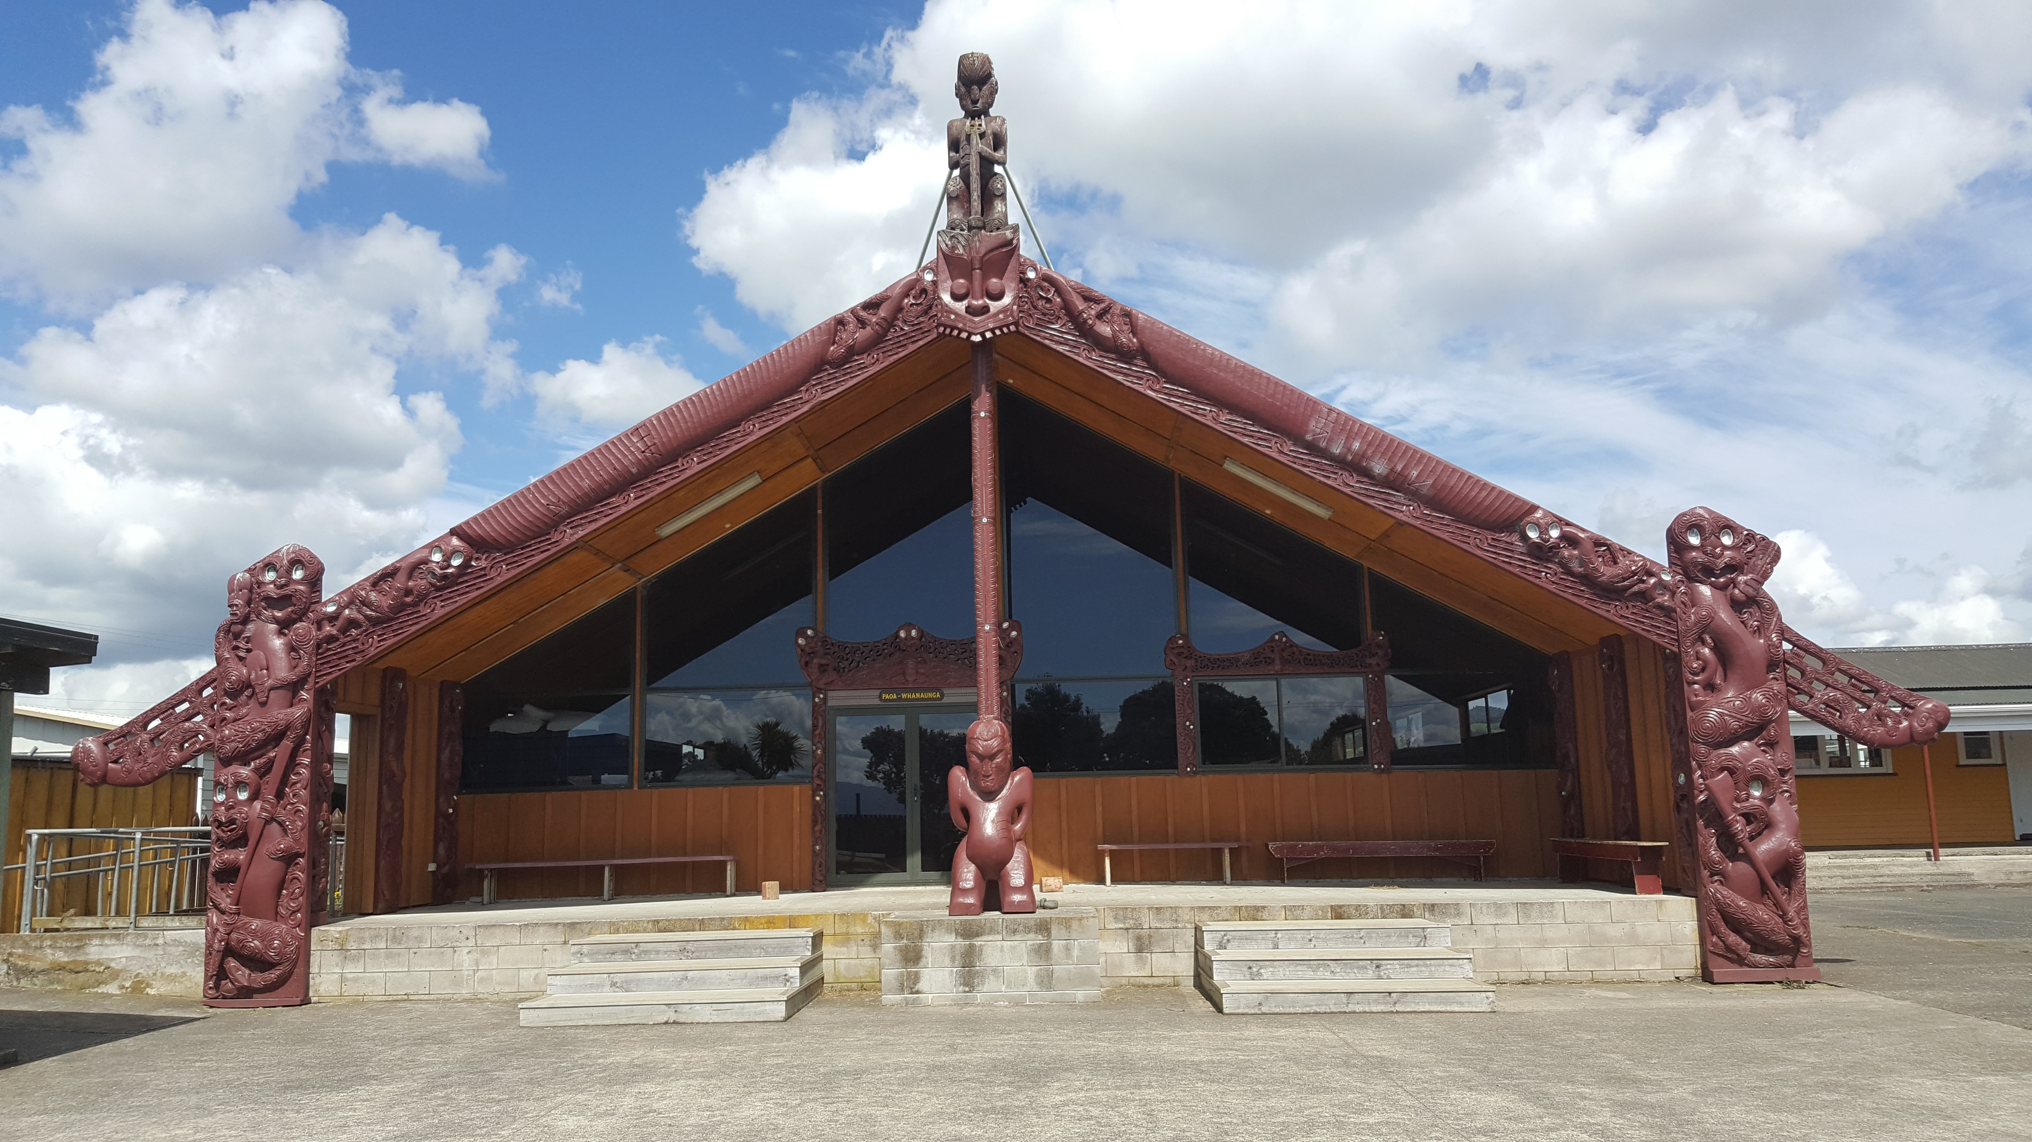
A whakapapa of violence and healing (A psycho-socio-historical analysis: how Aotearoa became New Zealand)
Donny Riki and Viv Roberts
donnyr@hotmail.co.nz
027 388-4045

Slide 2
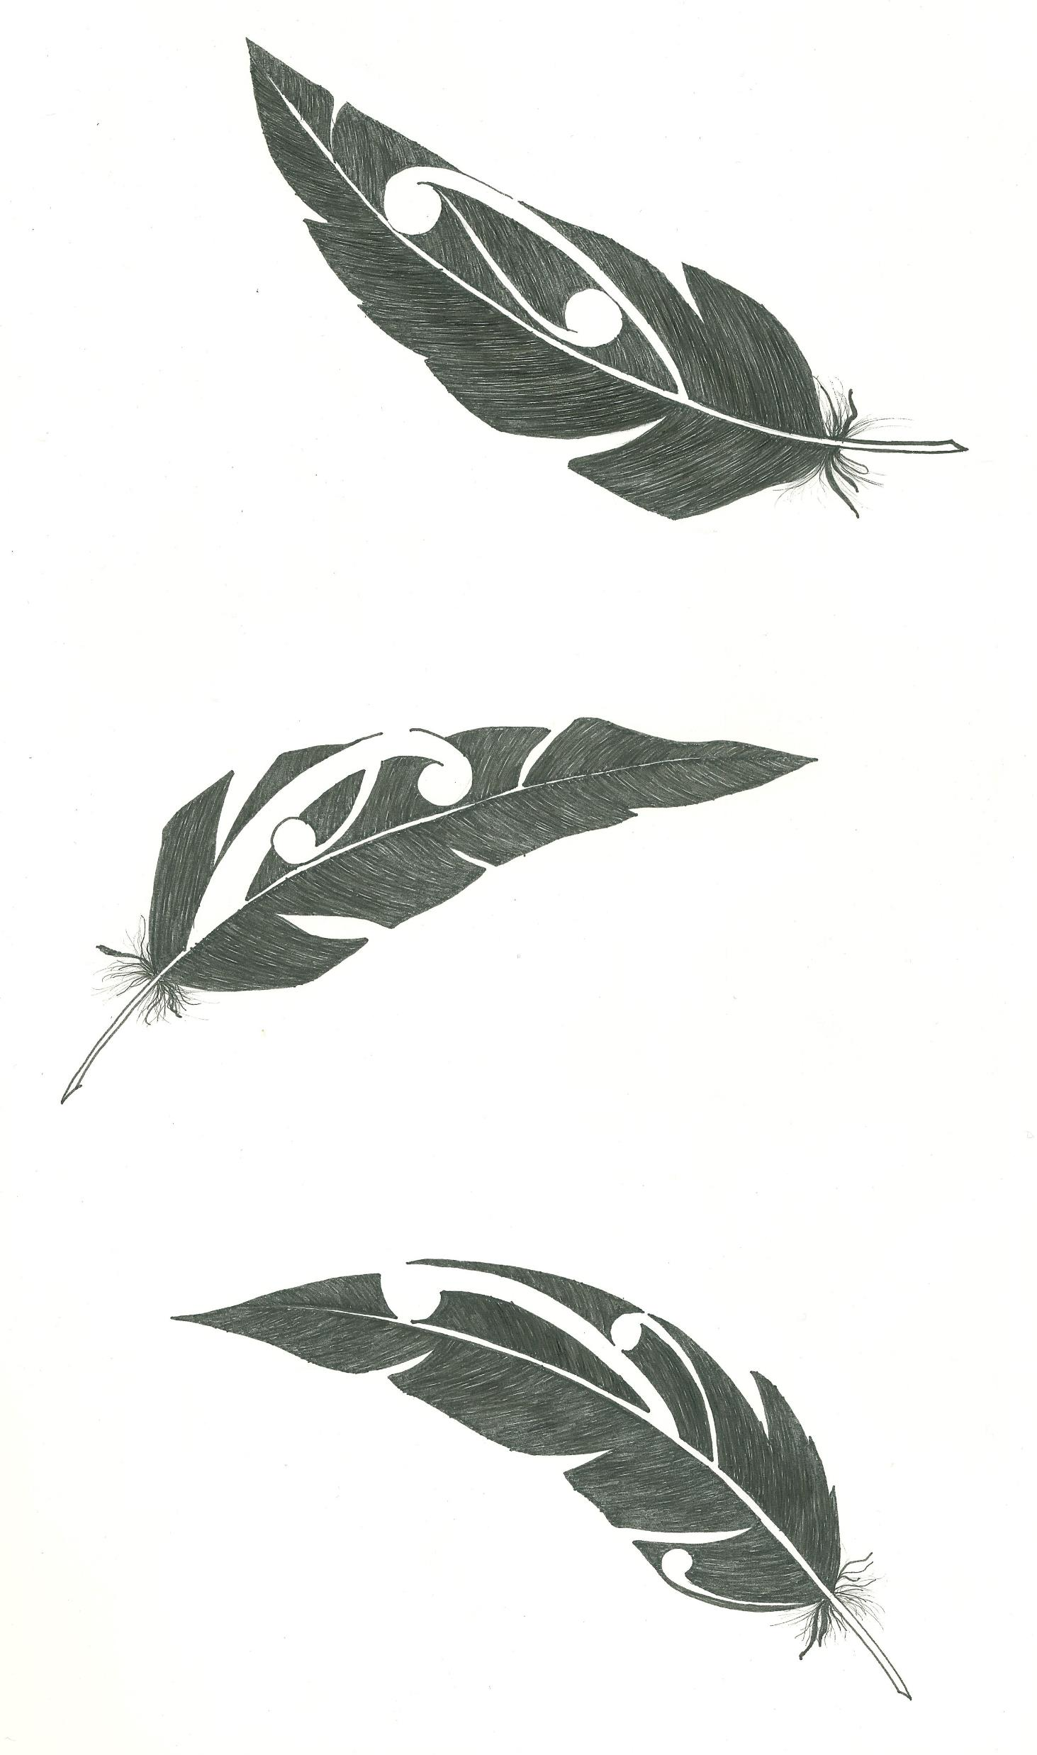
The first several minutes
of this presentation will be in
Te Reo Māori
My reasons for doing this should be clear by the end of this talk
Translations are given here

Slide 3
I acknowledge and honour the primordial ancestors, who made everything that there is.
(This includes Io-matua-kore, Ranginui, Papatūānuku, Tāne Mahuta, Rūaumoko, Tāwhirimātea, Haumietiketike,
Tūmatauenga, Tangaroa and Rongomātāne.
There are many more and a full discussion of this is beyond the scope of this talk)

Slide 4
I acknowledge and honour this building and the portion of Mother Earth on which it stands.
(Māori believe that all things have a life force and even ‘inanimate objects’ like houses, rocks and the earth have a ‘genealogy’ . This is complex and again is beyond the scope of this presentation).

Slide 5
Many thanks to the organisers of this conference and to all of you for coming to this session
(This small speech is a ‘Mihi’ and is an appropriate way to start a hui within the Māori world)

Slide 6
Karakia
Not a Not a prayer, but a way into ‘Te Ao Wairua’

Slide 7
Whakataka te hau ki te uru, Whakataka tō hau ki te tonga. Kia makinakina ki uta, Kia mataratara ki tai. E hi ake ana te ata kura he tio, he huka, he hauhu. Haumi e! Hui e! Taiki e!

Slide 8
Otaki river, near Arapito stream, Tararua ranges 6/11/22

Slide 9
Whakawhanaungatanga

Slide 10
Who am I?
I have 6 blood lines within me,
my ancestors came from Turkey,
France, Israel, Wales, Scandinavia,
and Poland.
My family have been in Aotearoa
for 5 generations but in the eyes
of Māori, I am a visitor/guest here,
and I acknowledge that position.

Slide 11
I was born and grew up in Wellington
My parents were Stan Roberts and Jocelyn St John (Researcher for Justice Dept in Wellington in the 1960s)
I currently live in Levin, Horowhenua
My partner is Donny Riki and between us we have 5 children.

Slide 12
I am a GP with 35 years experience
including 7 years working part time in psychiatry in Hastings.
My name is Viv Roberts
So I acknowledge you, all who listen, all who hear me.

Slide 13
This small speech is called a “Pepehā” and in my
experience is an appropriate way for relationship
to begin within the Māori world.
Many Māori meetings begin with every
participant giving their pepehā.
It seems to me that Māori are very interested to
hear “who you are from”, will consider this carefully
and filter “what you say” in the light of who you
are. This can be a barrier to Māori receiving effective healthcare.
(From a Pākehā point of view)

Slide 14
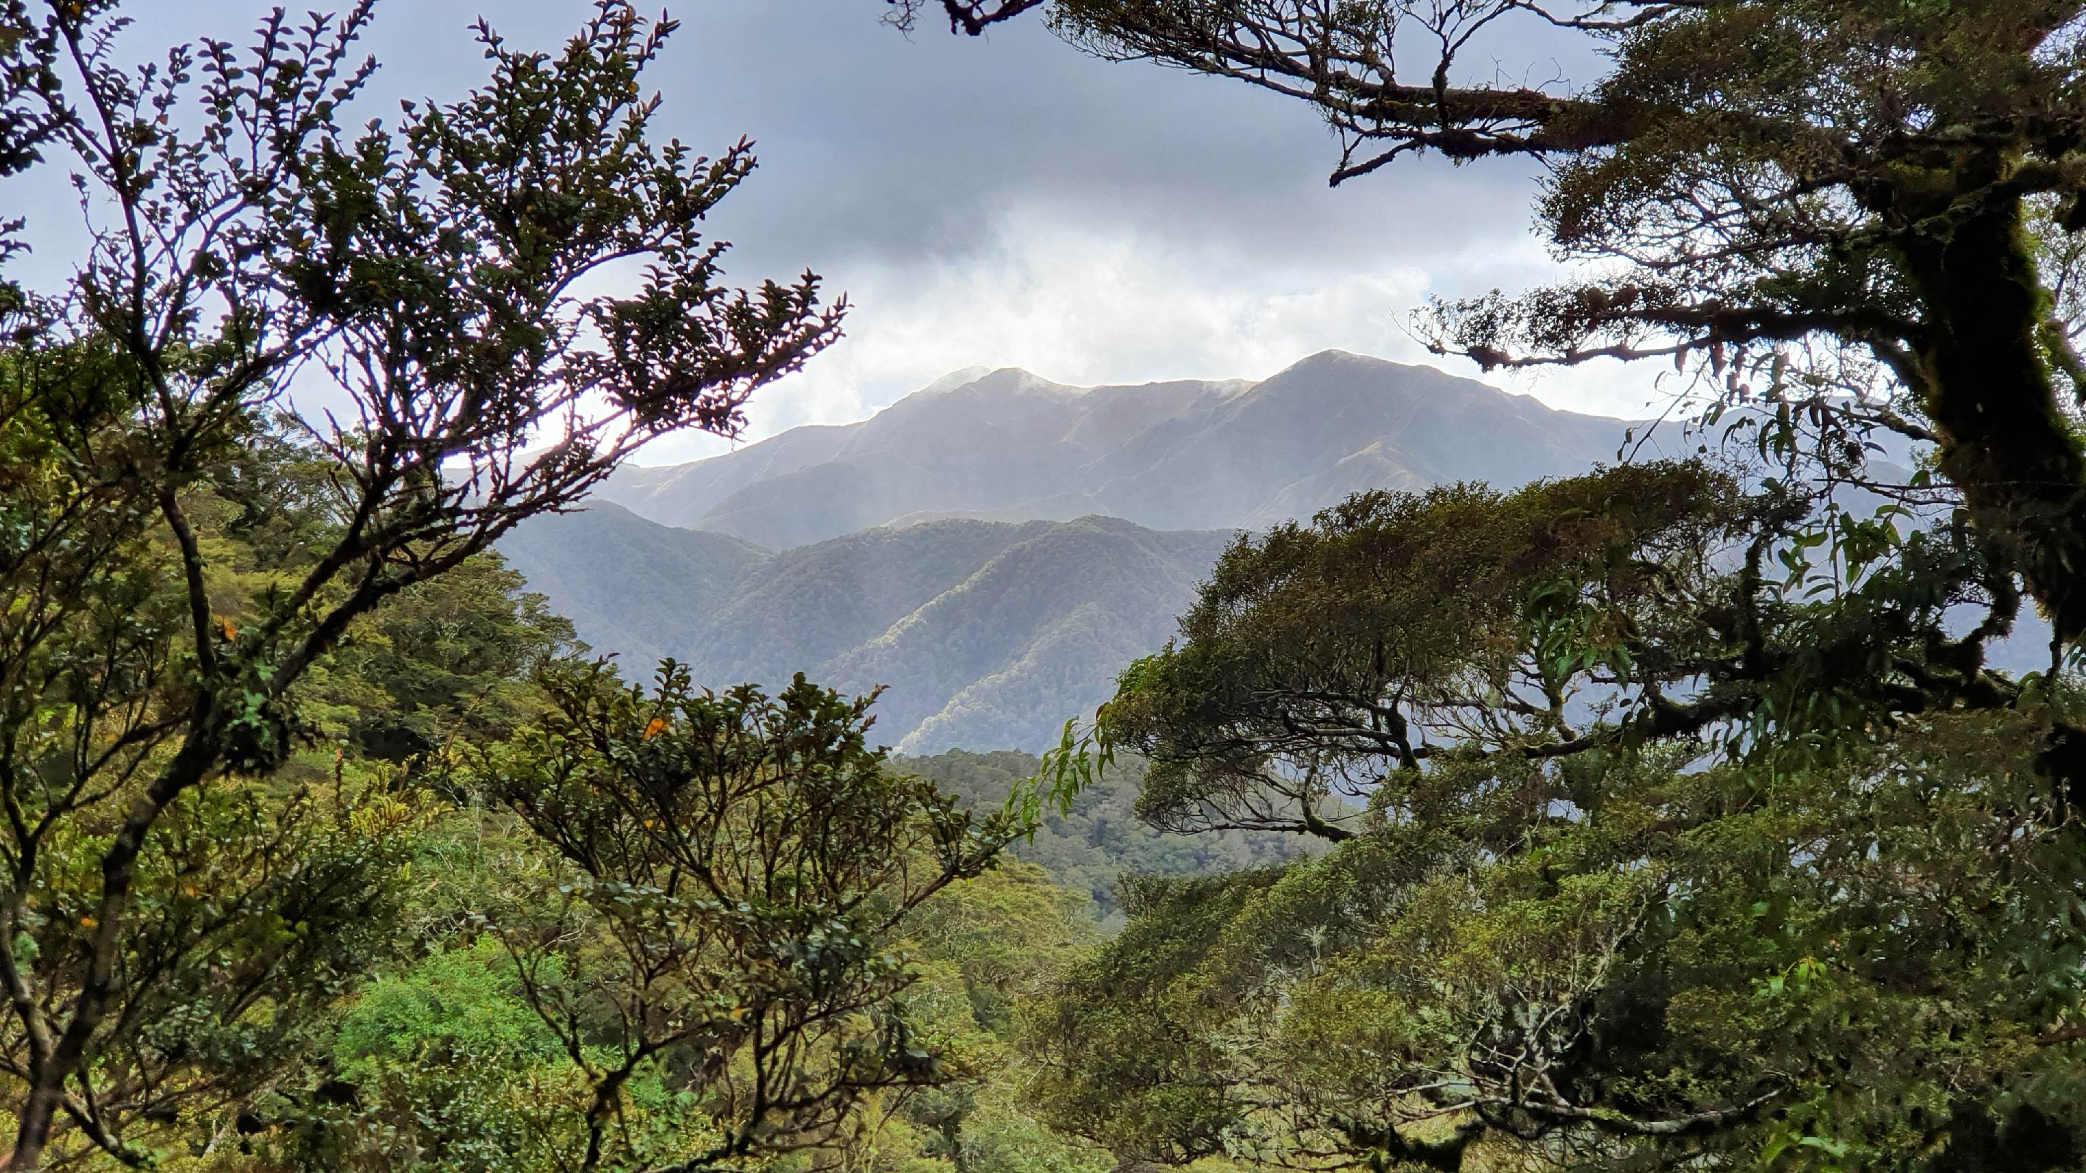
Tararua peaks 6.11.22

Slide 15
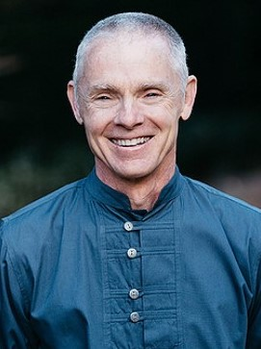

Slide 16
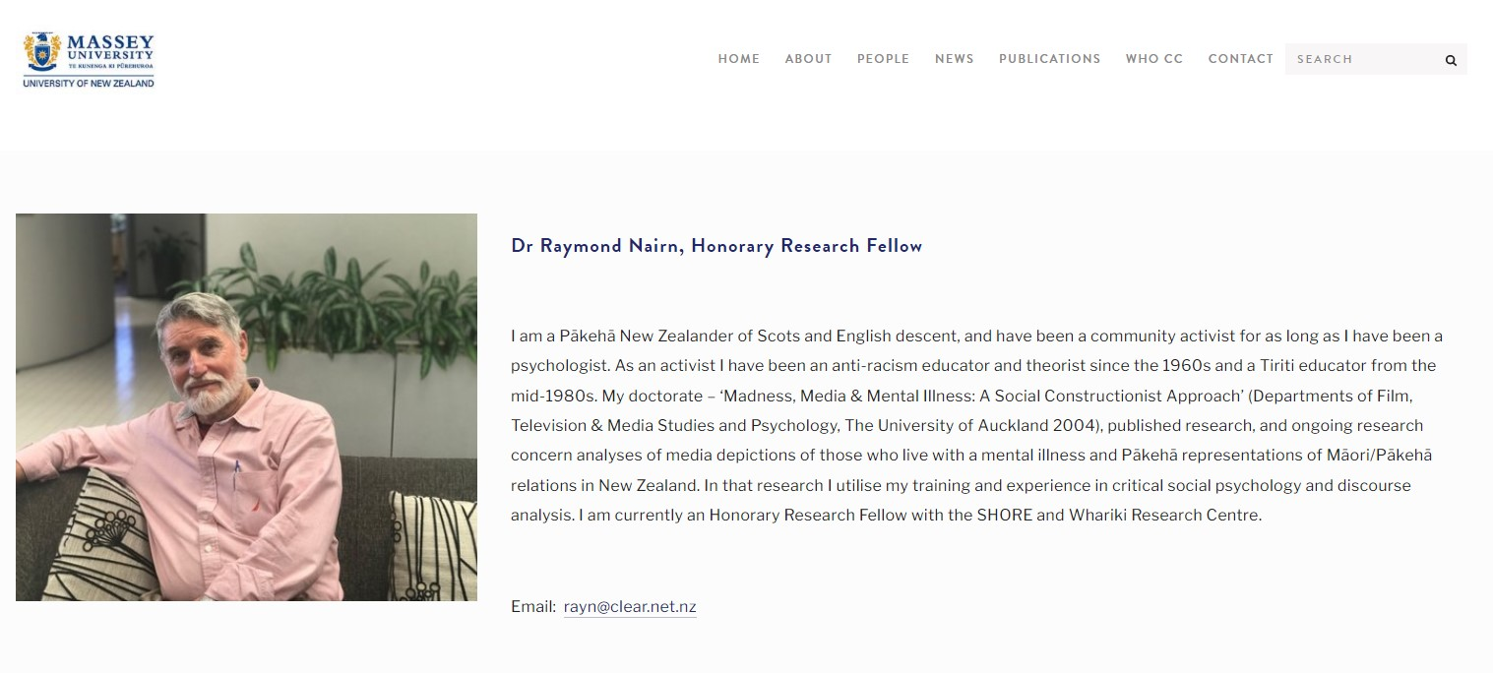
Pākehā have a vested interest
in staying ignorant!

Slide 17
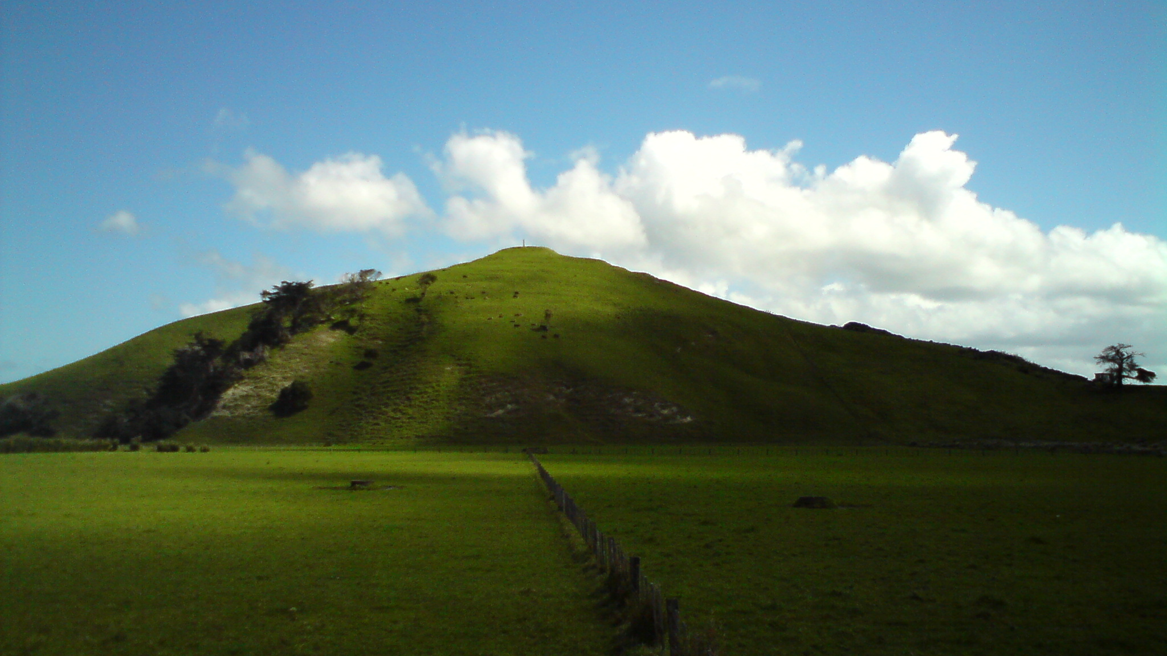

Slide 18
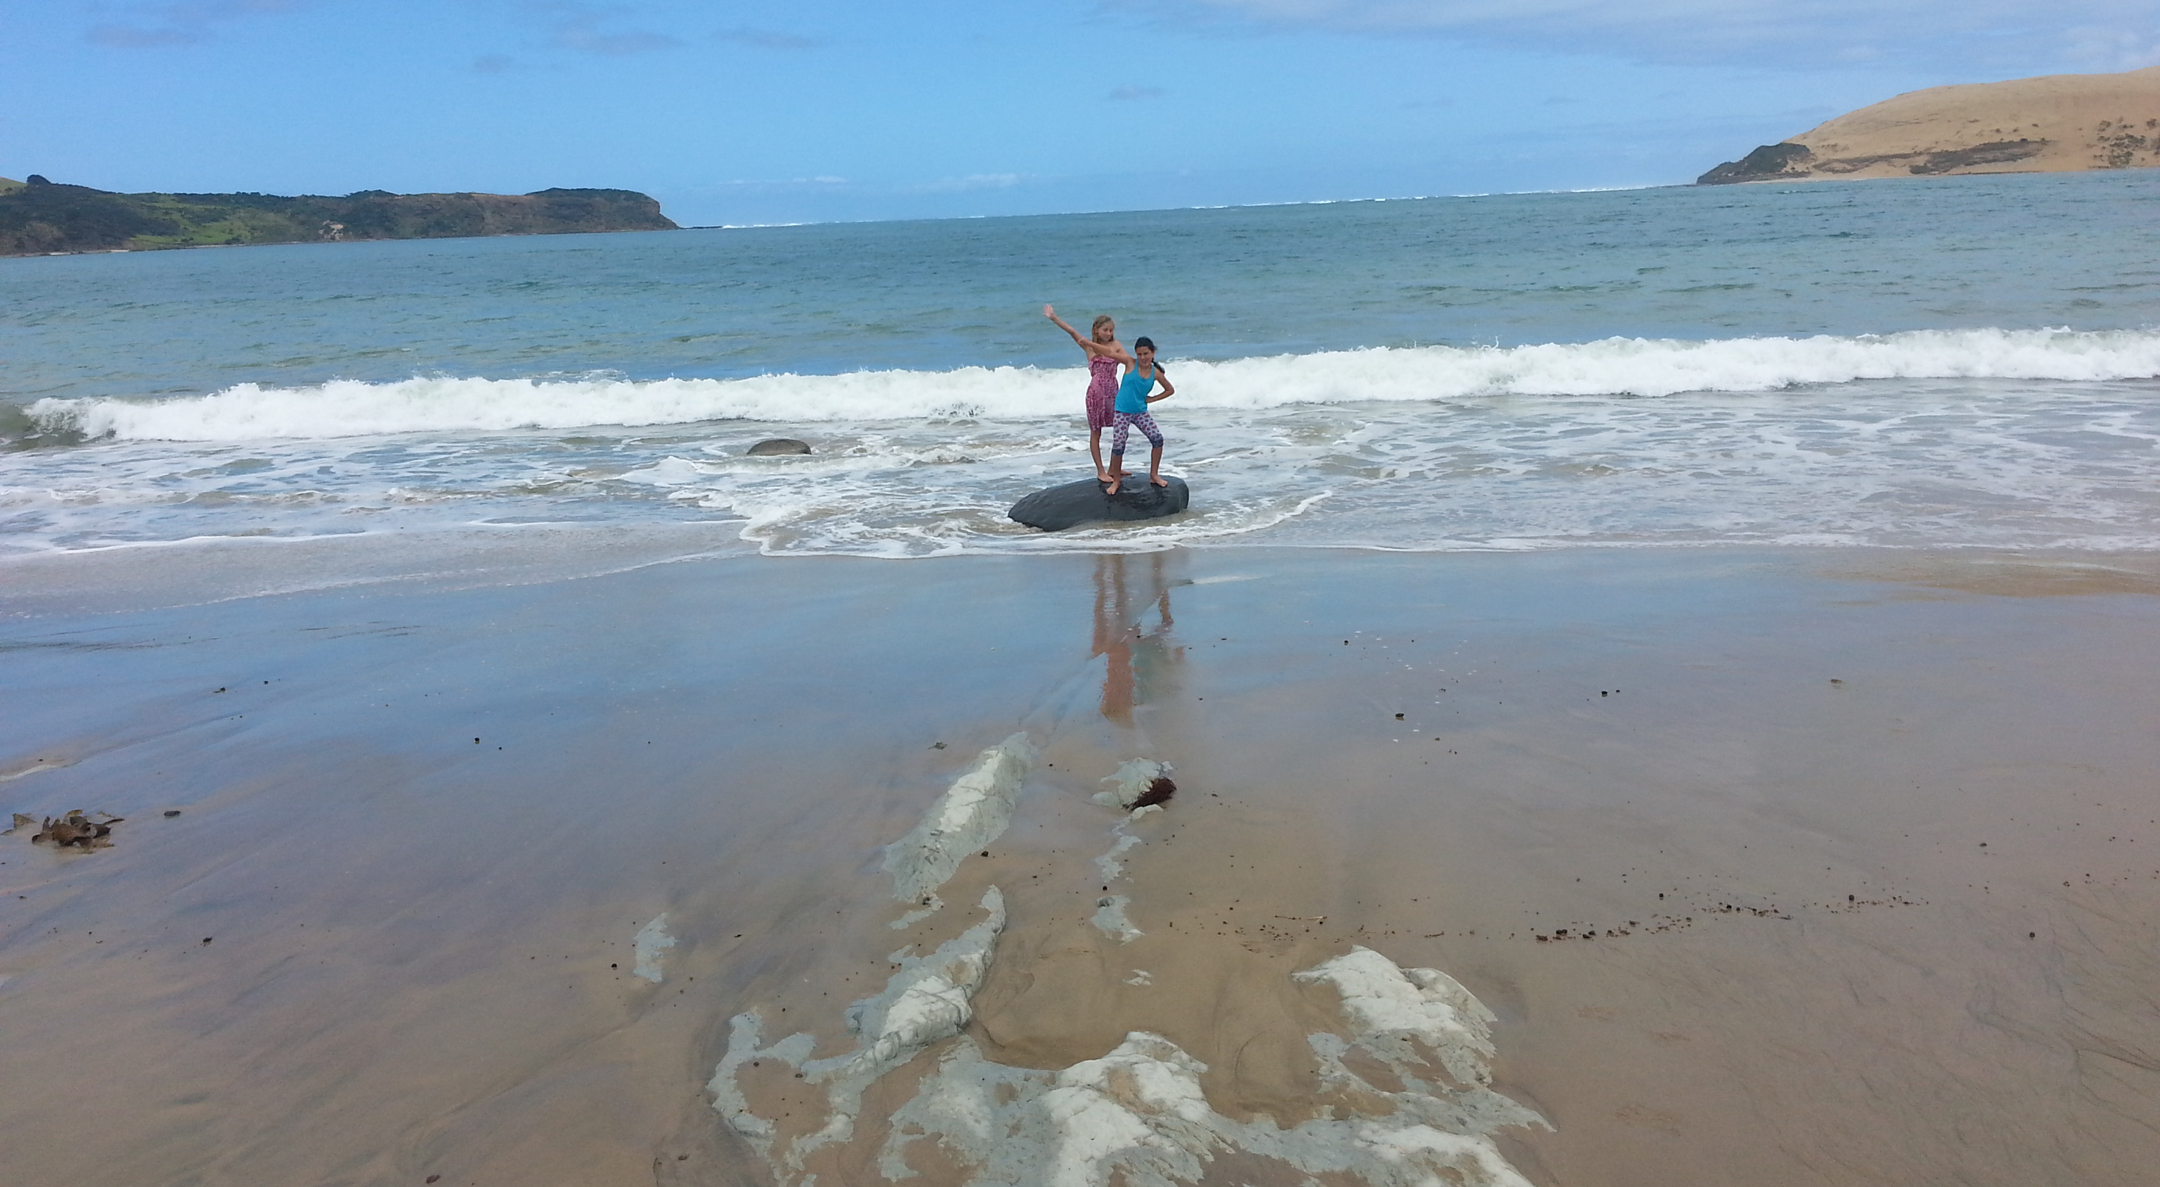

Slide 19
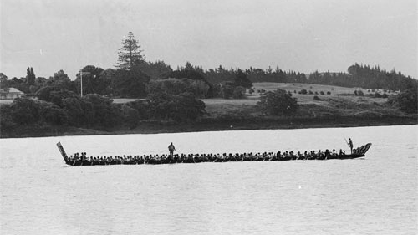

Slide 20
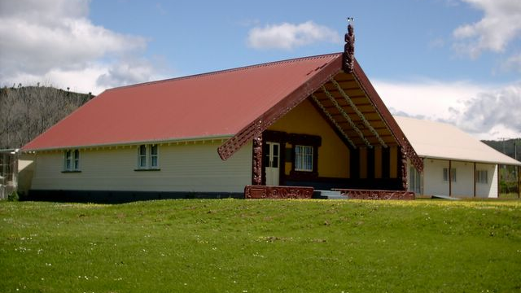

Slide 22
Ko Tuakiritetangata Pairama Riki
tōku ingoa tika ēngari
ko Donny Riki taku ingoa ture
I also identify as having straight cisgendered
white-partner privilege

Slide 24
Colonial Discourse
Colonization has always been based upon the existence of need and dependency. Not all people are suitable for being colonized; only those who feel this need are suitable. In almost all cases where Europeans have founded colonies . . . we can say that they were expected, and even desired in the unconscious of their subjects.
(Mannoni, 1947, cited in Macey)

Slide 25
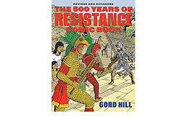
How to colonise a country
Step 1: Invasion
Step 2: Occupation
Step 3: Forced assimilation
(Step 4: Denial)

Slide 26
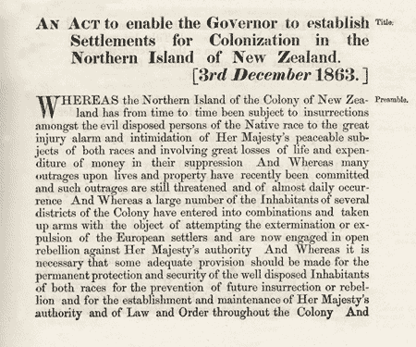
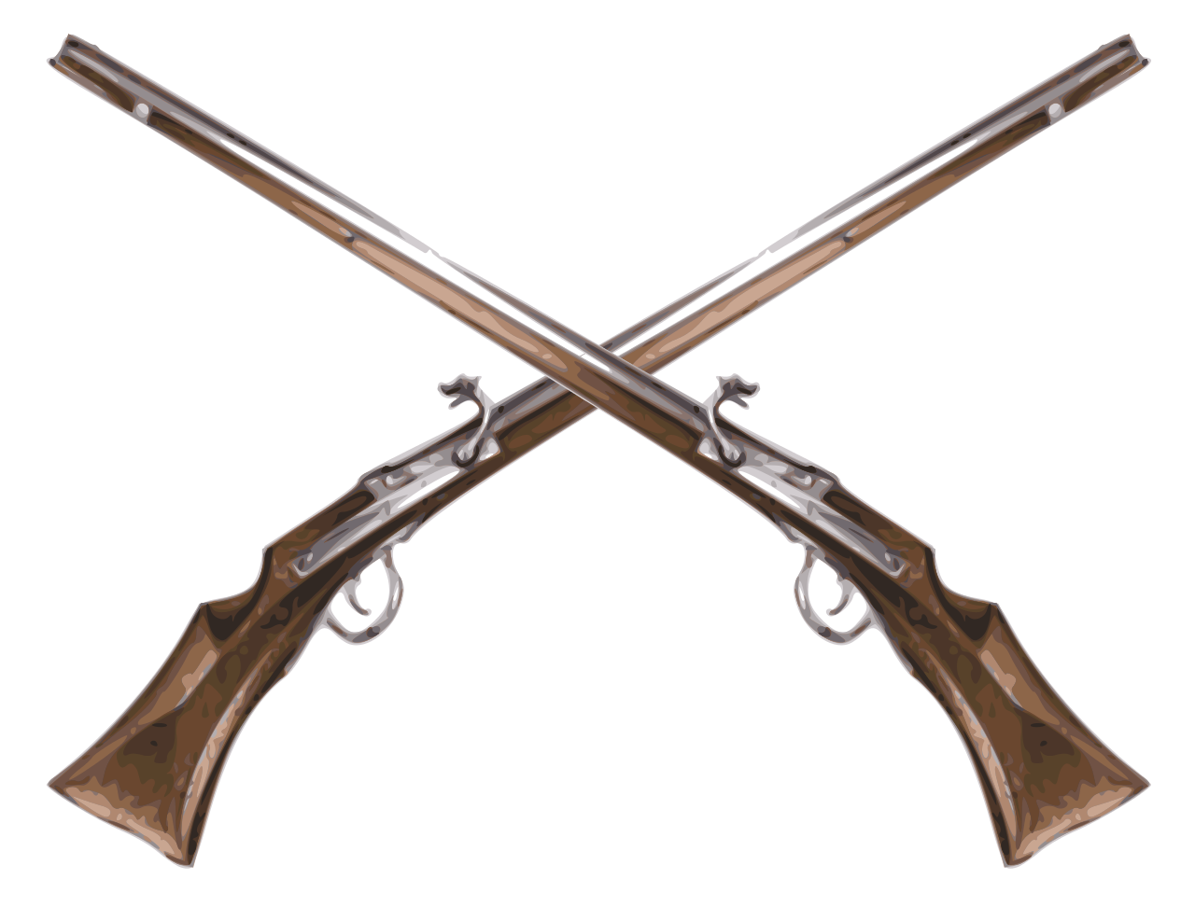
Step 1: Invasion

Slide 27
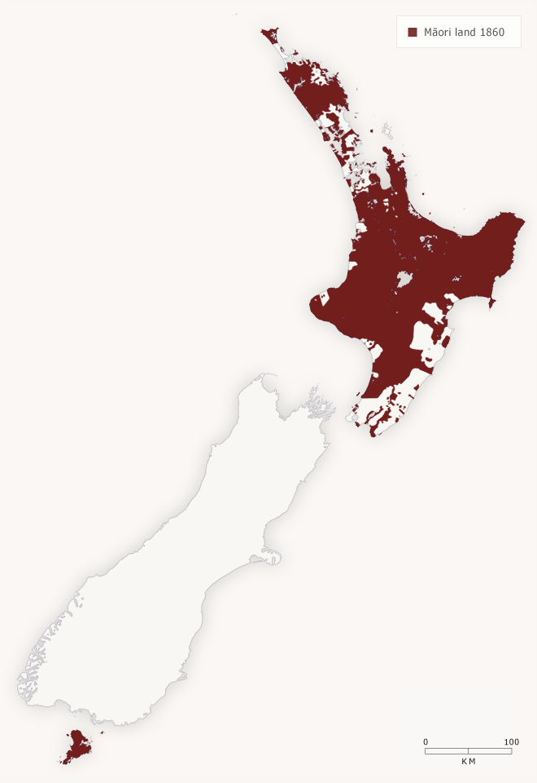
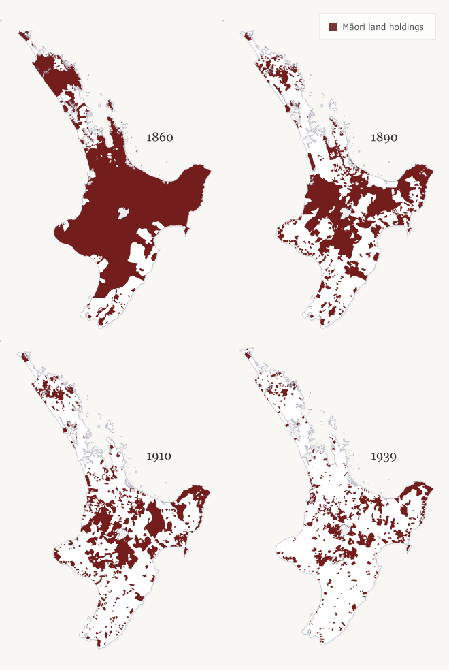
Step 2:
Occupation

Slide 28
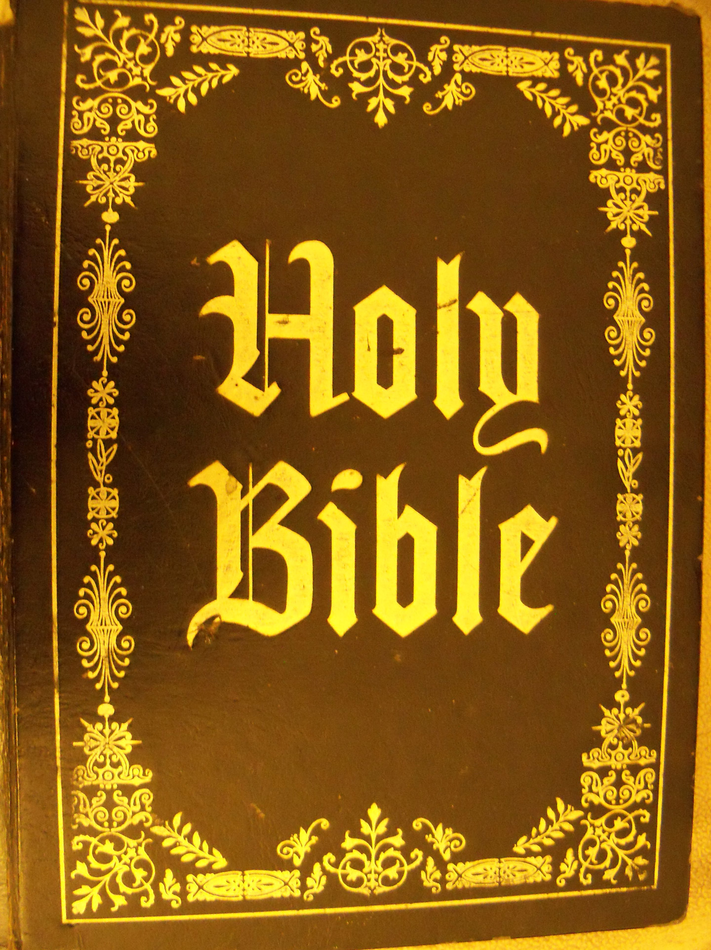
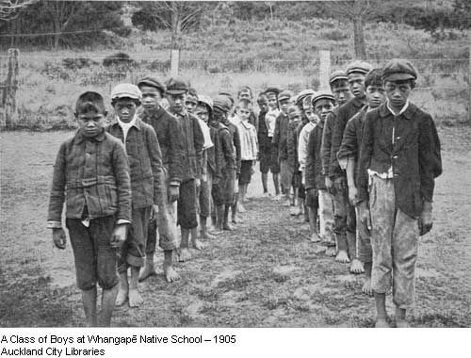
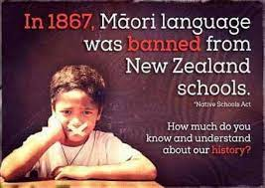
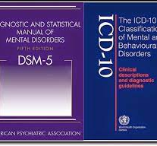
Step 3: Forced assimilation

Slide 29
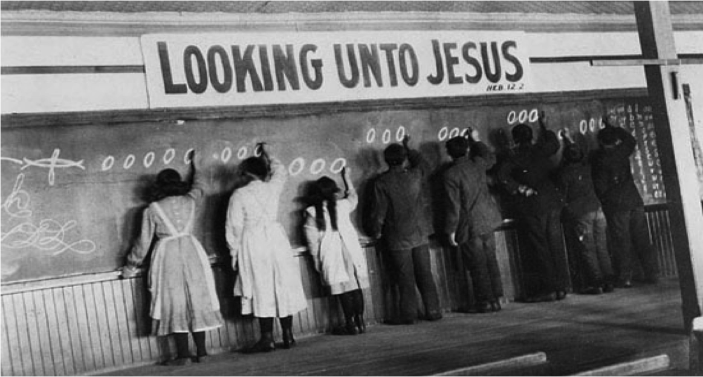
Colonisation is probably the greatest offence to the mana of a people (Wade, 1997)

Slide 30
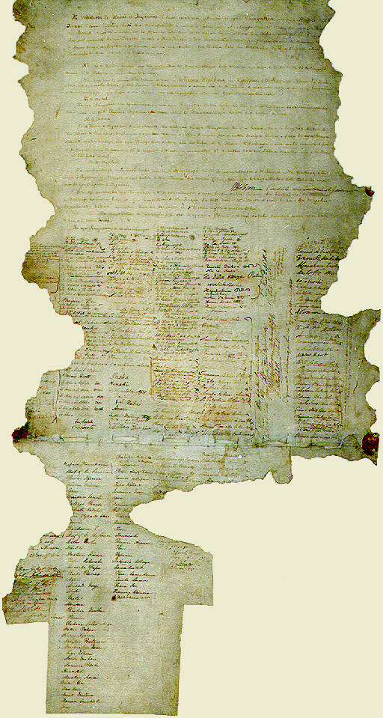
Māori response to genocidal and ethnocidal injustices
He Whakapūtanga 1835
Te Tiriti O Waitangi 1840
Treaty – 39 Rangatira signed by moko
Te Tiriti – over 500 rangatira

Slide 31
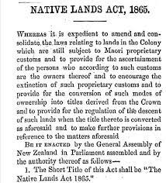
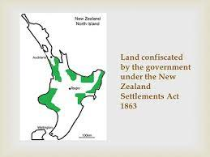
Colonial response to Māori response (resistance)
The New Zealand Settlements Act of 1863 provided for the confiscation of Maori land when the Crown determined an iwi, or a significant number of members of an iwi, had been in rebellion against the Queen

Slide 32
Māori resistance to Colonial response
1858 - Tewherowhero
1860 - Tāwhiao

Slide 33
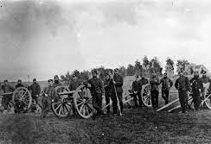
Colonial response to Māori resistance

Slide 34
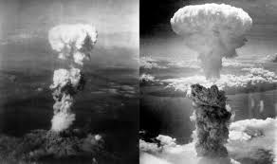
6/8/1945

Slide 35
Warning

Slide 36
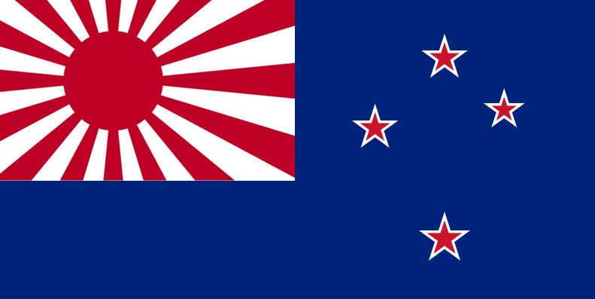
What if WW II had turned out differently?

Slide 37
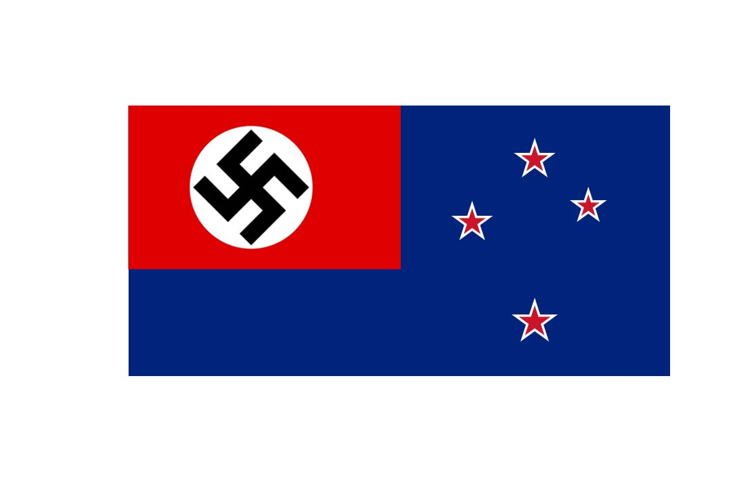

Slide 38
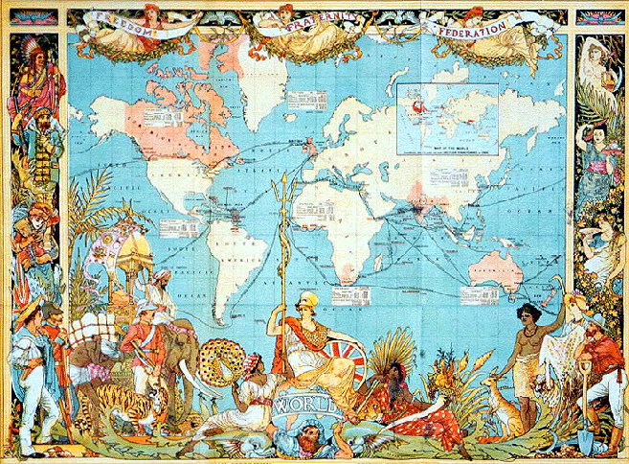
The colonial code in the helping professions…
You are deficient; I am proficient…
Therefore, I have the right (duty, mandate, task) of performing certain operations on you (labelling/diagnosing, fixing, assigning, directing, surveilling)…
For your own good!
(Todd & Wade, 1997)

Slide 39
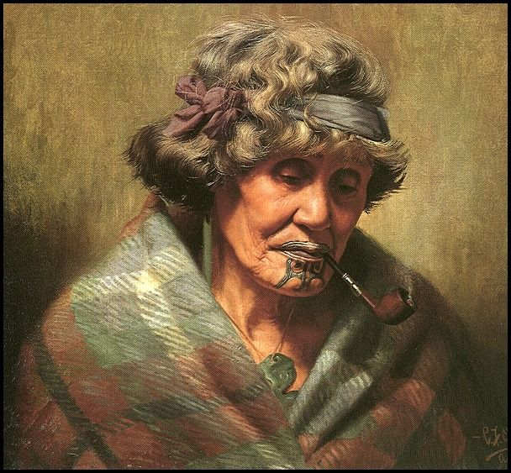
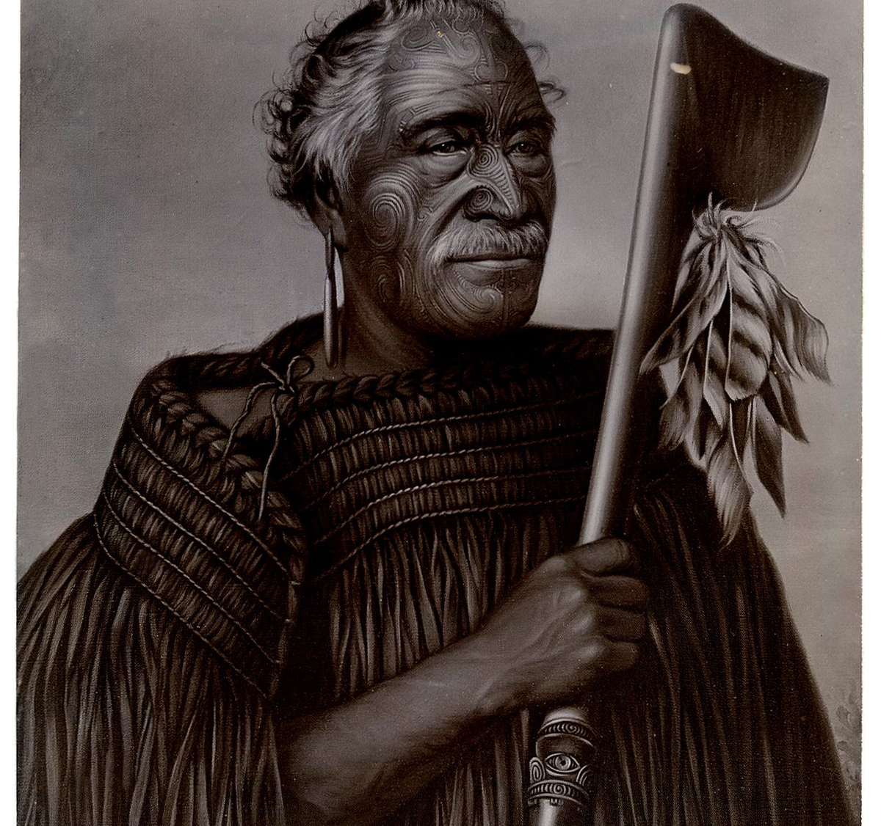
Generation 5 1830s – 1900s The era of my great grandparents
Legislation enforced:
He Whakapūtanga / Tiriti O Waitangi
1846 NZ Government Act
1852 Constitutions Act
1862 Native Lands Act
1863 NZ Settlements Act
1867 Native Schools Act
1871 Confiscated lands Act
1881 Māori prisoners Act

Slide 40
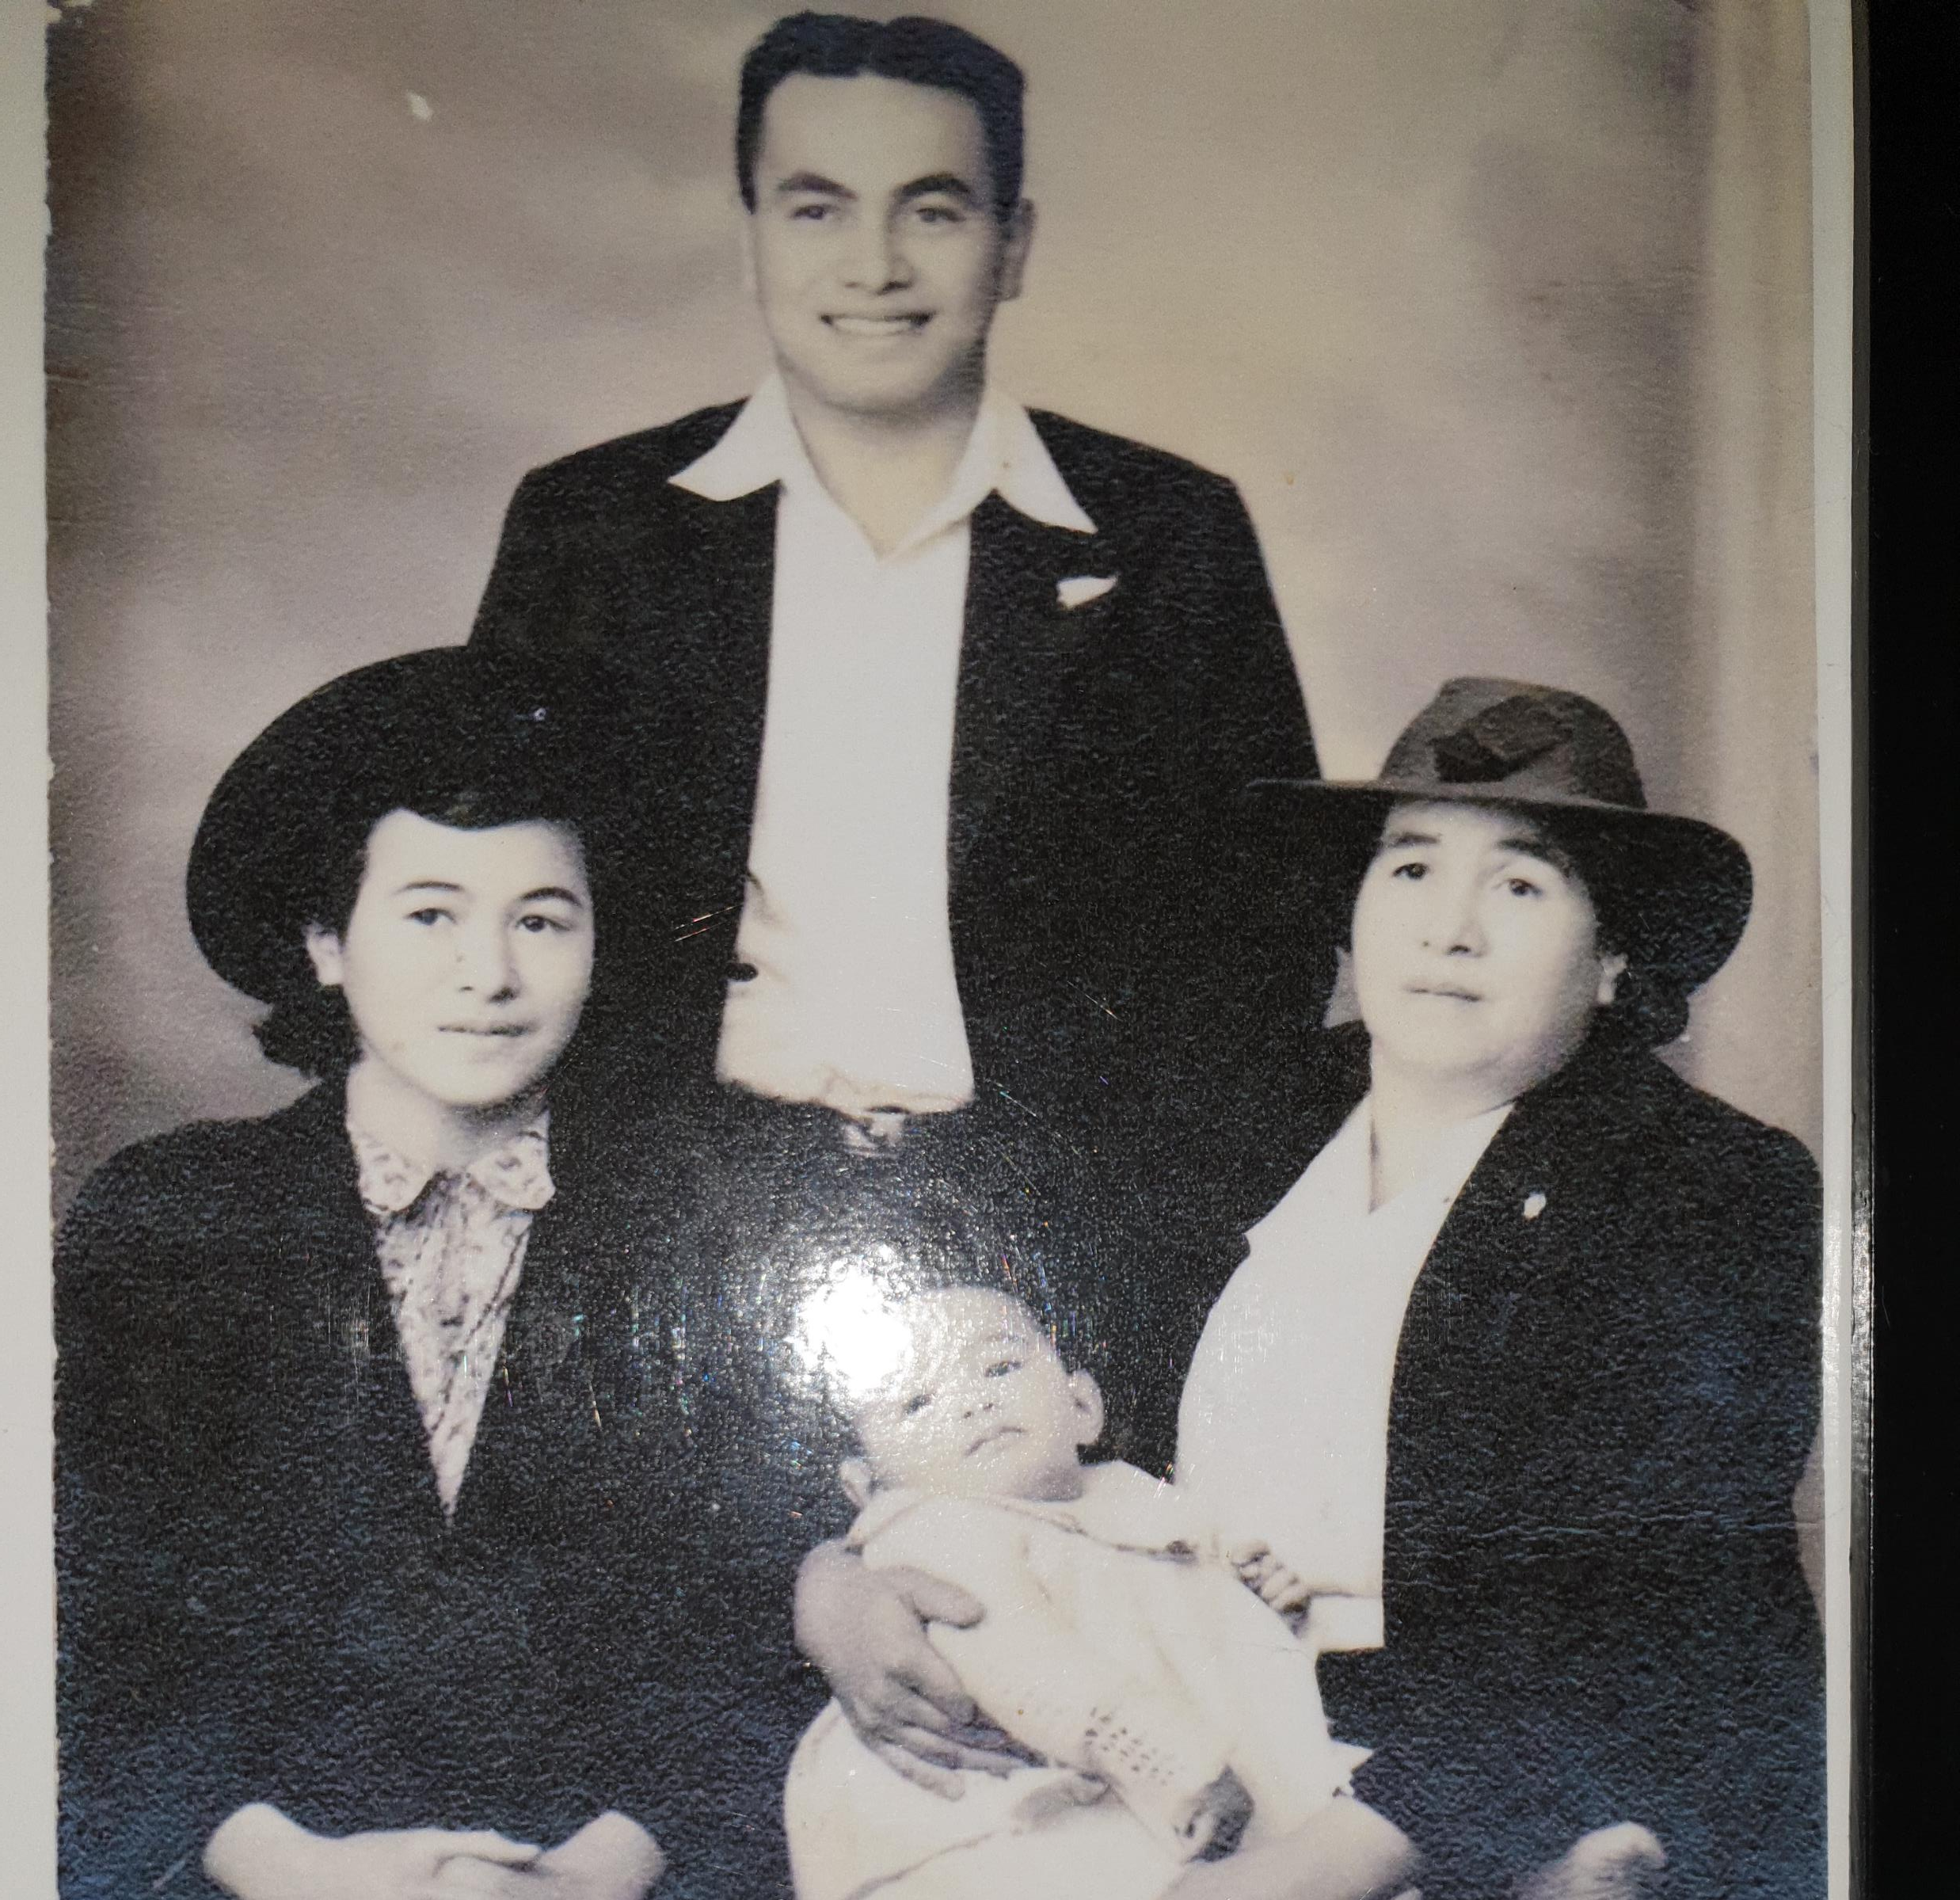
Generation 4 1900 – 1970s The era of my grandparents
ALL previous legislation PLUS….
1908 Tohunga Suppression Act
Native Health Act
Māori Land Amendment Act
Native Affairs Act
Town & Country Planning Act
Māori Trust Boards Act
Hunn Report
NZ Crimes Act
1967 Māori Affairs Amendment Act

Slide 41
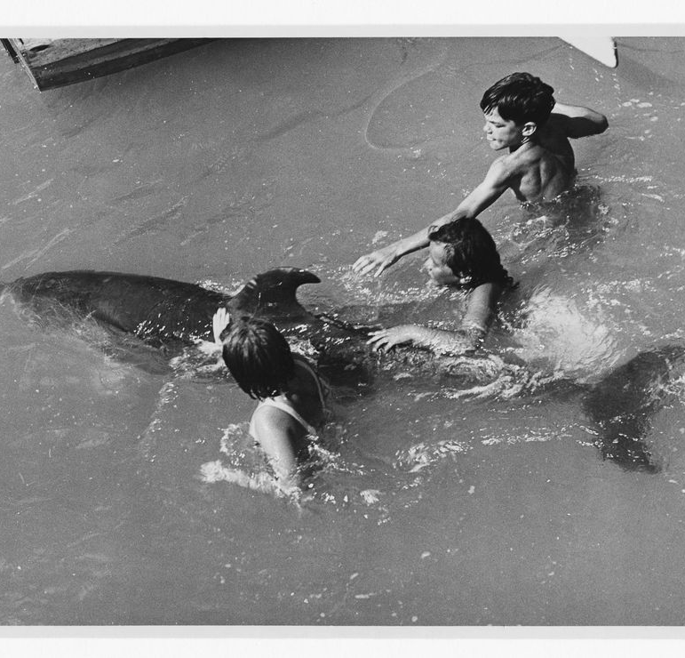
Generation 3 1940s – 1990s The era of my parents
ALL previous legislation PLUS…
1961 Hunn Report
1961 Crimes Act
1967 Māori Affairs Amendment Act
1986 NZ Constitution Act
1991 Resource management Act
1993 Companies Act
2004 Foreshore & Seabed

Slide 42
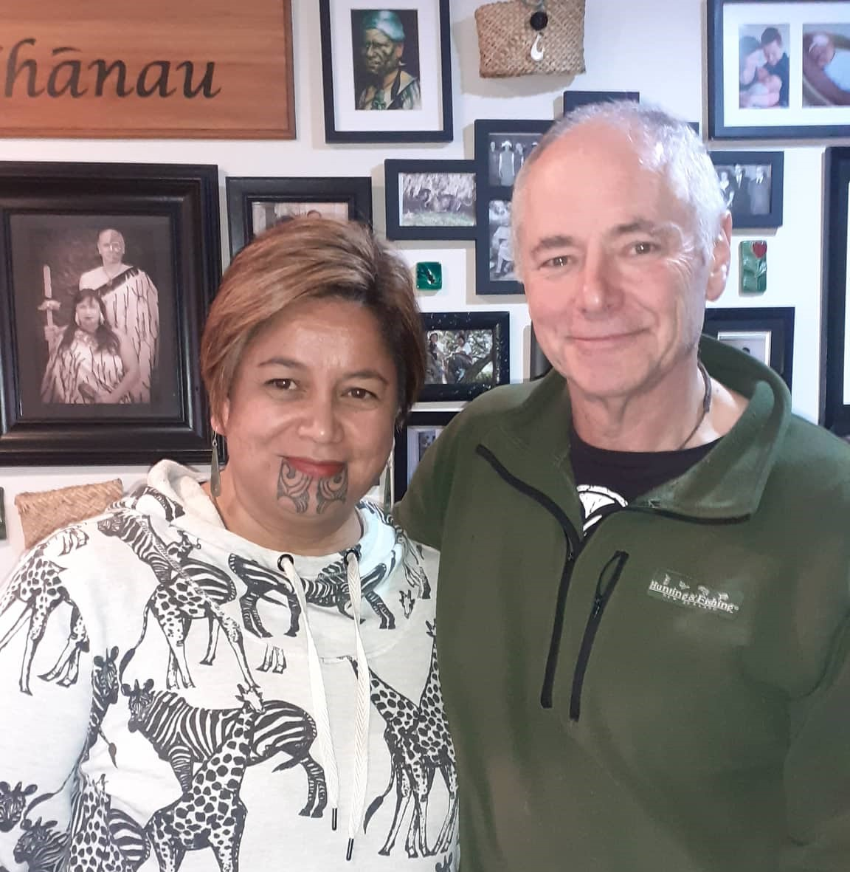
Generation 2 1960s on... My era
All previously legislation PLUS….
Te Ture Whenua Act 1993
Pu Ao Te Atatu 1986
NZ Constitution Act 1986
Foreshore & Seabed 2004
Takutai Moana Bill 2010
Oil Drilling
PBANZ 2008
HPCA 2003

Slide 43
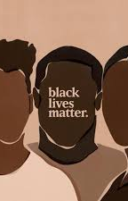
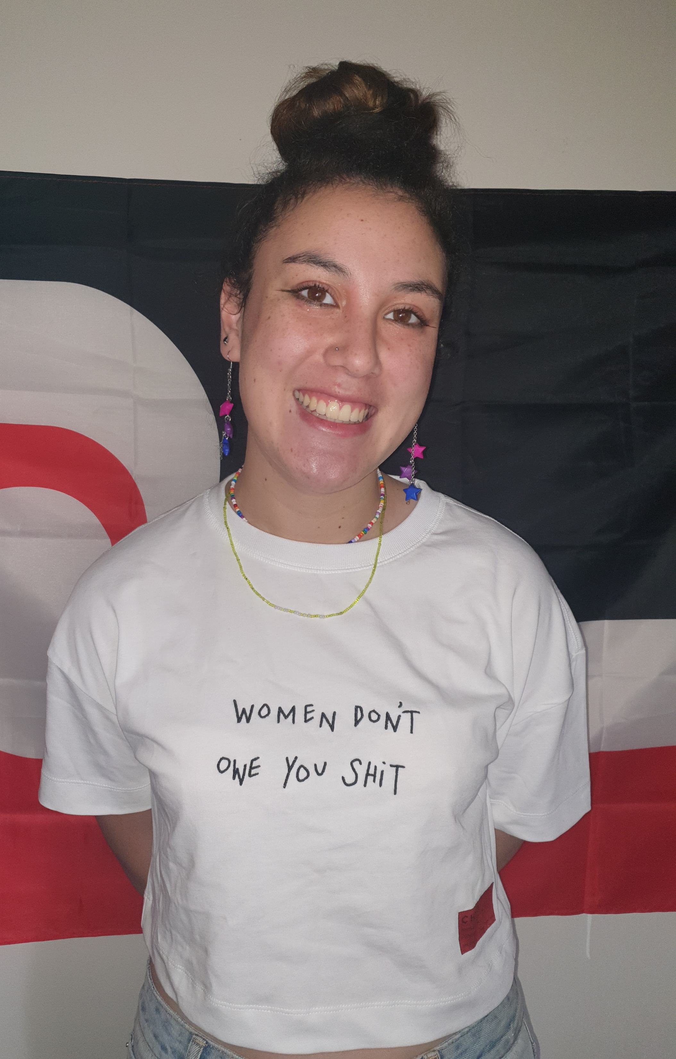
Generation 1 2000s – current: Our kid’s era
Age of activism for social justice, reindigenisation and shared consciousness...
Royal Commission Inquiry of Abuse in State Care
Goals for Viv’s kids: to have PhDs or mortgage free home by age 40 (Succeeding so far)
Goals for Donny’s kids: to not be raped or imprisoned by age 30! (Failed so far)

Slide 44
Waiata : Pūrea nei
Pūrea nei e te hau
Horōia e te ua
Whiti whitiā e te ra
Māhea ake nā pō raruraru
Mākere ana ngāhere
E rere wairua e rere
Ki ngā ao ō te rangi
Whiti whitiā e te ra
Māhea ake nā pō raruraru
Mākere ana ngāhere

